Slide 1
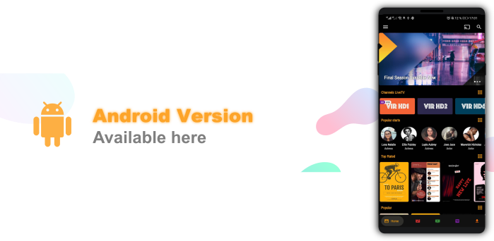
Movie & Web Series Portal
Online Subscription Charged Based OTT Platform
Github link: https://github.com/byomkesh2580/movie-portal
20101046 - Mouno Patrick Desilva
Github- https://github.com/mouno-patrick-desilva
20101045 - Md. Habibur Rahman
Github- https://github.com/byomkesh2580
20101041 - Munmun Islam Mim
Github- https://github.com/iam-mim

Slide 2

01
YouTube and other social media are full of ads and Clickbait. It decress the user interface and uncomfortable for watcher to view the content
Problem Definition :
02
There is a lot of OTT service in Market, But we are providing all types of movies from all platform. Consumers can watch our movies/serires/live TV from anywhere and anytime with cost effective plan
03
For a newbies or Startup Content Creator its harder to grow from social media and earn easily. We will provide them support and help them to grow with us from starting.

Slide 3

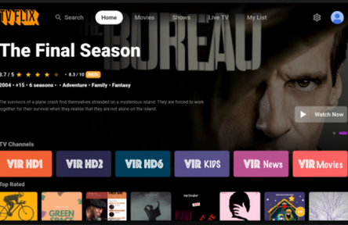
Your Company Name
Product Mockups

Slide 4


Requirement analysis (functional according to SRS):
Registration with Subcription
Start Consuming Content
Login
track the consumer’s motivation, interests, and customer personas by linking technologies and utilizing real-time analysis

Slide 5
Objective:
Unlimited access to movies
Promote the Underrated Content Creator
All in One with Consumer Freedom.
his comes as a huge plus because there are a lot of websites oline that host movies. If you miss a movie you are searching for on one particular site, you can simply redirect to another website that hosts the same film. Online movie storage servers are usually massive and can host a lot of movies and videos at a time
Exceptionally New and Underrated Content Creator Can Upload their Content In our Platform and get extra revenue and free promotion from us and by getting a boost so that they can reach their goals.
What you Need? Movie/Series/Online TV We Provide all of them. Our App Supported in Mobiles and PC both so easily accessible from anywhere and anytime.

Slide 6
Impact on Society:
Start From Scratch
Great Content That Doesn’t Cost Much
Entertainment For All
The startup content creator can upload their content our platform so that they can get a good extra good compact reliability from us and also native and new content can be found.
However, Our platforms also entertain the older generations or senior people to a certain level. Since the platforms constantly update their database with new content, it helps older people reduce their loneliness.
As we provide all content along with tv server, people don't need to buy different platform for different content. so its cost effective for the consumers and save their pocket also.

Slide 7
Product Roadmap And Project Cost
Preparation and Learning Proccess
Finding Resource
Start the Frontend/Mockup
Start with Database
Start With Backend
Deply and Testing
Jan.
Feb.
Mar.
Apr.

Slide 8
Thank You

